Slide 1
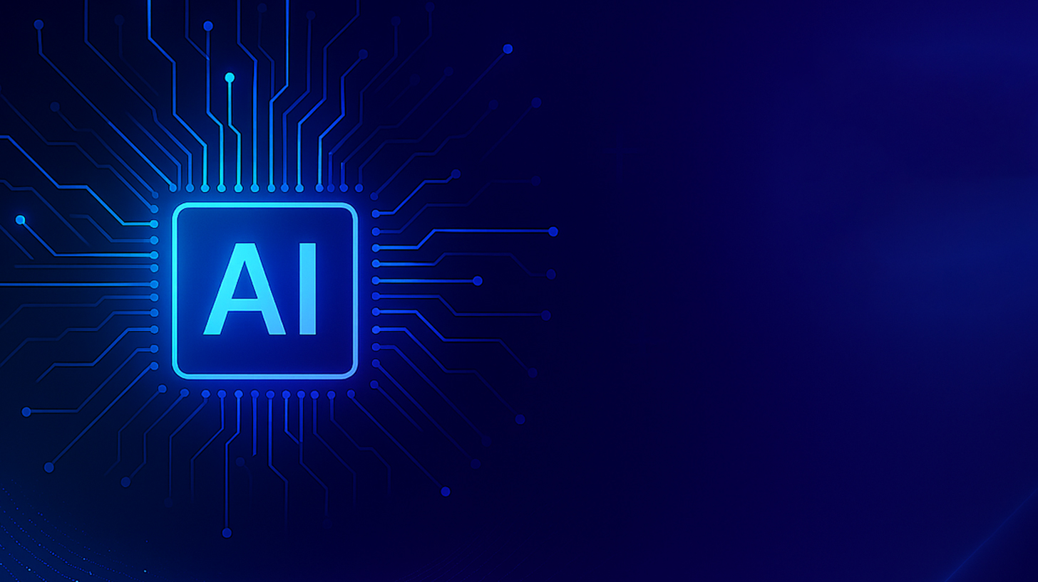
AI Literacy in Higher Education and Its Impact on Universities
2026
3/12
Jingchun Jiang
Notes:
主讲人时间AI Literacy in Higher Education and Its Impact on UniversitiesAiPPT202X.X

Slide 2
Background
• Generative AI tools became popular after ChatGPT was released in 2022.
• Teachers and researchers started thinking about how students should learn to use AI.
• This led to the idea of AI literacy in higher education.
• Many universities began discussing how AI may change teaching and learning.
Notes:
01020304• Generative AI tools became popular after ChatGPT was released in 2022.Background• Many universities began discussing how AI may change teaching and learning.• Teachers and researchers started thinking about how students should learn to use AI.• This led to the idea of AI literacy in higher education.

Slide 3


What is AI Literacy?
It includes the ability to use AI tools responsibly.
Students should also evaluate AI critically.
AI literacy means understanding what AI is and how it works.
AI literacy helps people work with AI in school, work, and society.
Notes:
01020304AI literacy means understanding what AI is and how it works.What is AI Literacy?It includes the ability to use AI tools responsibly.Students should also evaluate AI critically.AI literacy helps people work with AI in school, work, and society.

Slide 4
Research Focus of the Article
Part 01
Part 02
The article studies AI literacy frameworks used in education.
The researchers analyzed 18 different frameworks.
Part 03
Part 04
They examined how these frameworks describe AI, students, and teachers.
The study also looks at the metaphors used to explain AI in education.
Notes:
The article studies AI literacy frameworks used in education.Research Focus of the ArticleThe researchers analyzed 18 different frameworks.They examined how these frameworks describe AI, students, and teachers.The study also looks at the metaphors used to explain AI in education.

Slide 5
How AI is Described in the Frameworks
Part.01
Part.02
Part.03
Part.04
AI is often described as a tool that helps students learn.
Some frameworks describe AI as a transformer that can change education.
AI is also seen as something that is everywhere in modern society.
At the same time, some researchers say AI can be a threat if it is used incorrectly.
Notes:
01020304AI is often described as a tool that helps students learn.How AI is Described in the FrameworksSome frameworks describe AI as a transformer that can change education.AI is also seen as something that is everywhere in modern society.At the same time, some researchers say AI can be a threat if it is used incorrectly.

Slide 6

How Students Are Described
01
Students are often described as analysts. They should examine and evaluate AI tools carefully.
02
Students are also creators who can use AI to produce ideas or projects.
03
Some frameworks describe students as citizens who think about ethics and responsibility.
Notes:
Students are often described as analysts. They should examine and evaluate AI tools carefully.How Students Are DescribedStudents are also creators who can use AI to produce ideas or projects.Some frameworks describe students as citizens who think about ethics and responsibility.

Slide 7
How Teachers Are Described
They design learning activities that include AI tools.
Teachers are often described as designers.
Teachers are also guides who help students understand AI.
Teachers help students use AI responsibly and think critically about technology.
Notes:
01020304Teachers are often described as designers.How Teachers Are DescribedThey design learning activities that include AI tools.Teachers are also guides who help students understand AI.Teachers help students use AI responsibly and think critically about technology.

Slide 8

Conclusion
AI literacy is becoming an important topic in universities.
AI is changing how students learn and how teachers teach.
Students need critical thinking skills when using AI.
Teachers play an important role in guiding students in the AI age.
Notes:
Part 01Part 02Part 04Part 03AI literacy is becoming an important topic in universities.ConclusionAI is changing how students learn and how teachers teach.Students need critical thinking skills when using AI.Teachers play an important role in guiding students in the AI age.

